Slide 1

Lab 5: Simple Circuits
PHY2049L
Section: 016

Slide 2
Learning Outcomes
Students will apply their basic knowledge in test equipment.
Students will be able to differentiate between a series resistor circuit and a parallel resistor circuit.
Students will become familiar with the measurement process of both circuits.
Students will be able to analyze both circuits using Ohm’s Law.

Slide 3
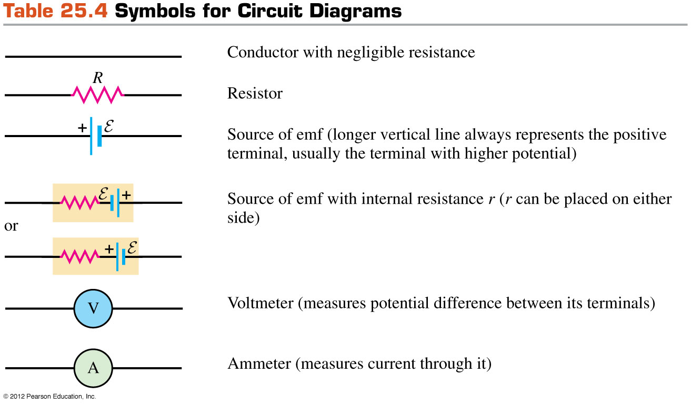
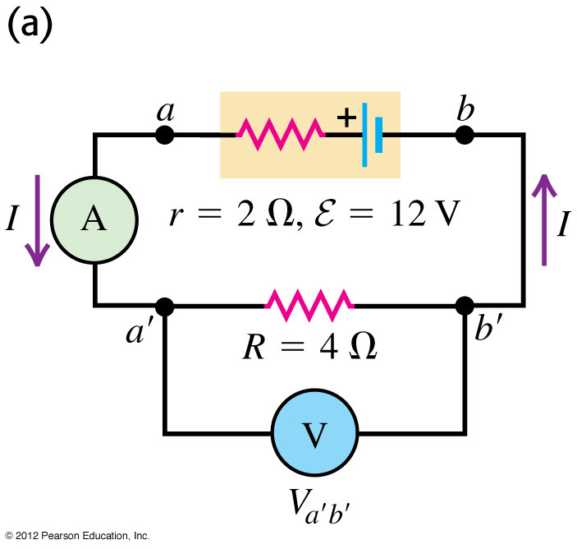
Drawing Circuit Elements

Slide 4

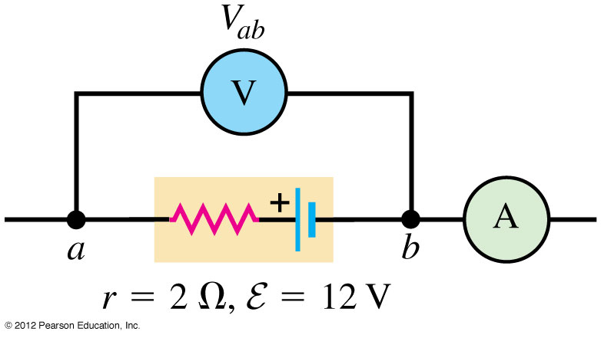
Resistors
Resistors are “linear” circuit devices. This means that they obey Ohm’s Law. (Are there circuit elements that aren’t linear?)

Slide 5
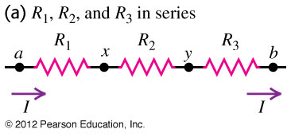
Resistors Connected in Series
Only a single path for the current to flow, therefore every resistor connected in series will have the same current!
This will be equal to the current “through” the battery.
Use Kirchoff Loop Rule to find the total resistance.

Slide 6
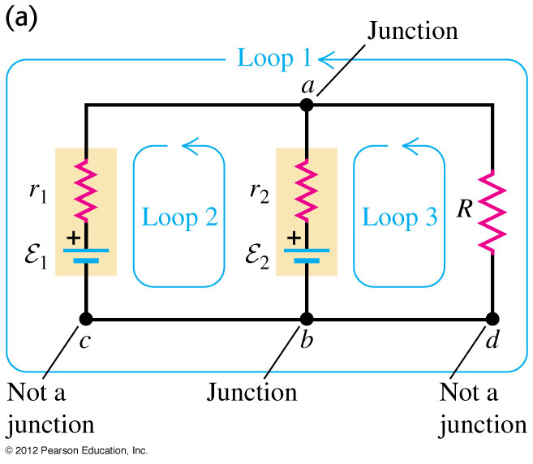
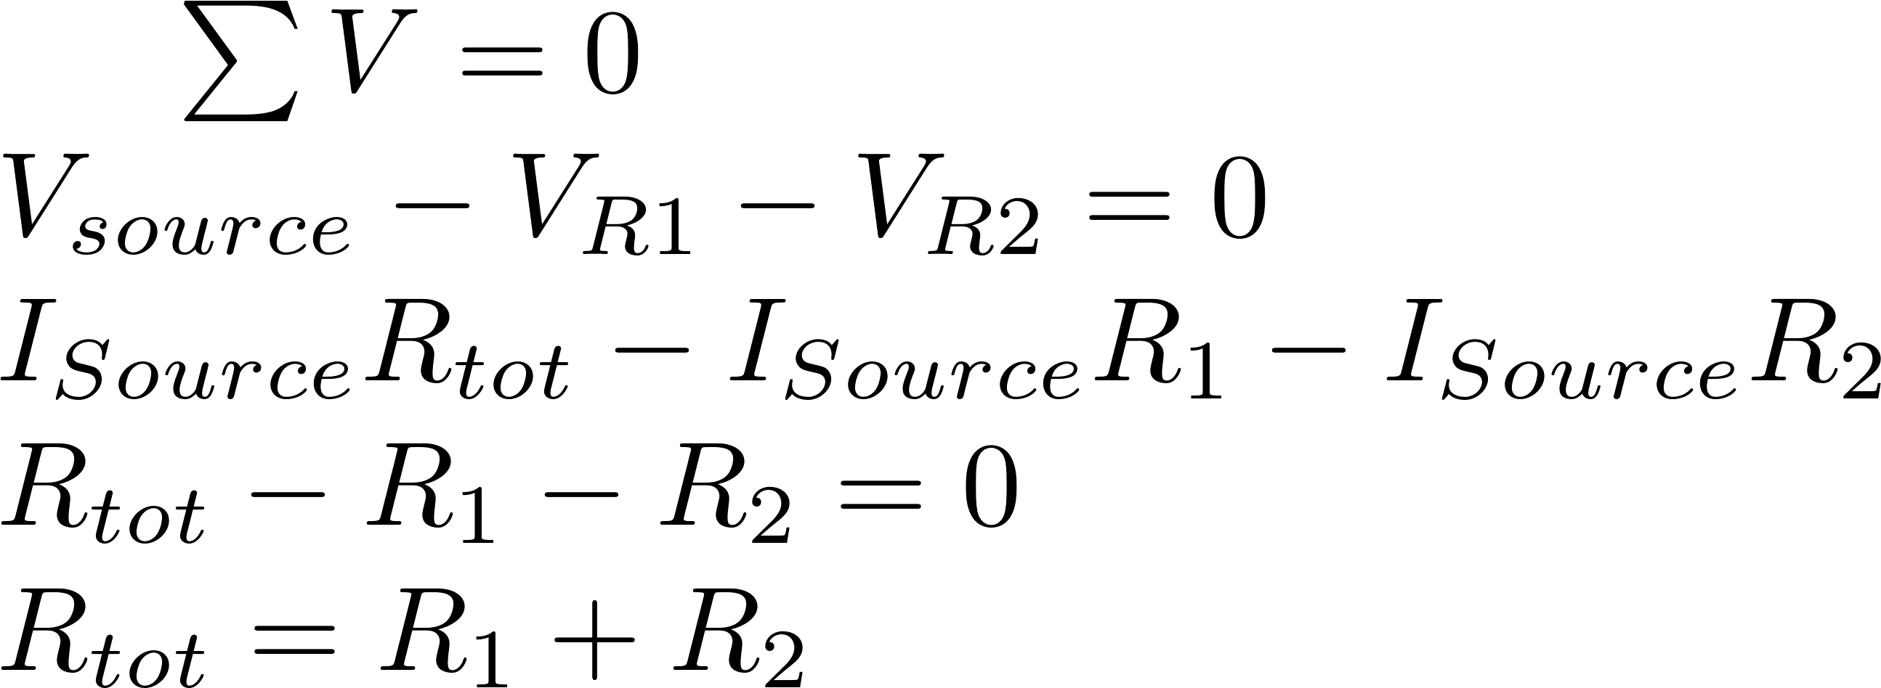
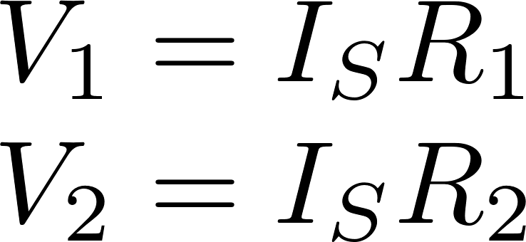
Resistors Connected In Series
The theoretical voltage drop across each resistor is given by:

Slide 7
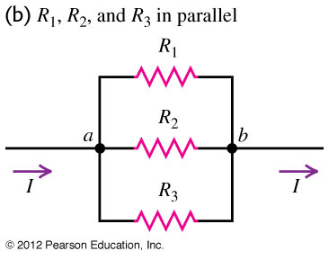
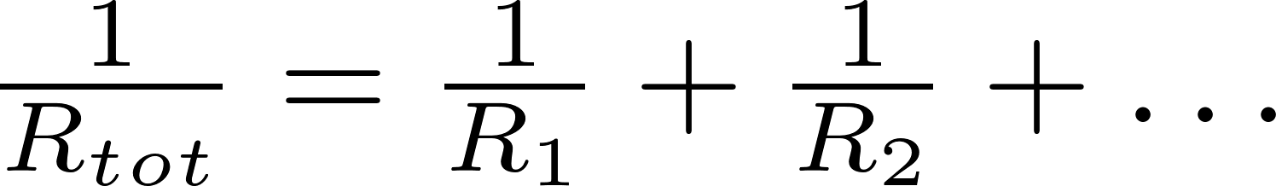
Resistors Connected In Parallel
The resistors are now connected at a junction point (the current has two possible paths to travel).
Each end of the two resistors are directly connected to one end of the battery. The resistors have the same voltage.
Use Junction Rule to find total resistance:

Slide 8
Simple Circuit
Building two simple circuits with breadboards:
Circuit with two resistors in series.
Circuit with two resistors in parallel.
Use the multimeters to take an accurate measurement
DO NOT EXCEED 5V on your power supply! Make sure to measure this voltage (the power supply is a liar!)
Where will you measure the current for the Parallel resistor?

